Slide 1
UNIVERSITY LIBRARY DATA WAREHOUSE PROJECT REPORT
PREPARED BY GROUP NO 6
MEMBERS
NO | NAMES | REG NUMBER
1 | DUSABIMANA Wellars | BT000801IT26F
2 | BIZIMUNGU Emmanuel | BT002201IT26F
3 | NDAYISENGA Theophile | BT001401BT26F
4 | SINGIZWA Gideon | BT002301BT26F

Slide 2
Introduction
A university library manages different types of information, including book checkouts, digital resource downloads, and study room bookings. Analyzing this information helps the university understand how students use library services.
This project develops a University Library Data Warehouse to organize library data, support analytical queries, and present useful information through an interactive dashboard. The system uses MySQL for data storage, Python for data processing and ETL, and Streamlit for data visualization.

Slide 3
Project Objectives
To design and implement a dimensional data warehouse for university library data.
To organize library information using dimension tables and fact tables.
To develop an ETL process for loading data into the data warehouse.
To analyze book checkouts, digital downloads, and study room bookings.
To implement OLAP operations, including drill-down, roll-up, slice, dice, and pivot.
To develop an interactive dashboard for displaying library performance indicators and charts.
To validate the data warehouse using SQL queries and functional tests.

Slide 4
Technologies Used
MySQL: Database management and data storage.
Python: Data processing and ETL development.
Streamlit: Interactive dashboard development.
Pandas: Data manipulation and analysis.
Visual Studio Code: Project development environment.

Slide 5
System Architecture
The University Library Data Warehouse follows an ETL-based architecture. Source data is prepared and loaded into a MySQL database, where it can be analyzed and presented through a Streamlit dashboard.
Source data: Sample library data containing book checkouts, digital downloads, and study room bookings.
ETL process: Python scripts extract, transform, validate, and load data into the database.
Data warehouse: MySQL stores the data in dimension and fact tables.
Analytical processing: SQL queries and OLAP operations support data analysis.
Visualization: The Streamlit dashboard displays key performance indicators, charts, and interactive analytical results.

Slide 6
Dimensional Model
The data warehouse uses a dimensional model consisting of three dimension tables and three fact tables.
Dimension tables
DIM_STUDENT: Stores student information, including student number, department, and study level.

Slide 7
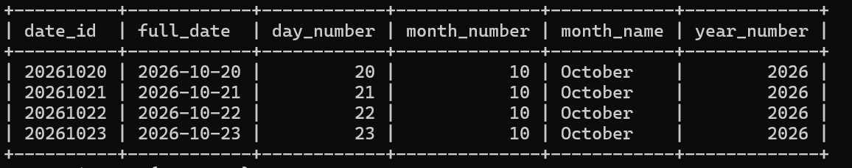
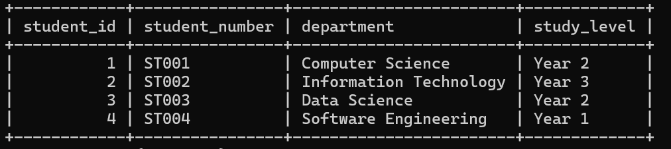
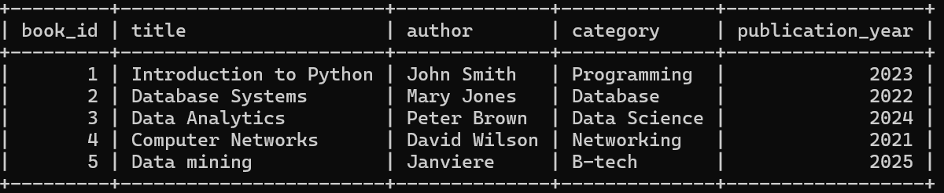
DIM_DATE: Stores calendar information, including the full date, day, month, and year.
DIM_STUDENT: Stores student information, including student number, department, and study level.
DIM_BOOK: Stores book information, including title, author, category, and publication year.

Slide 8
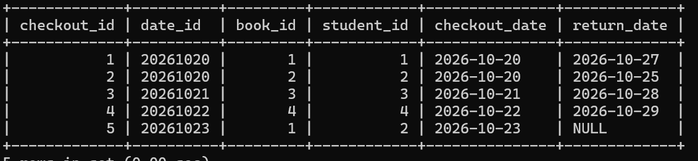
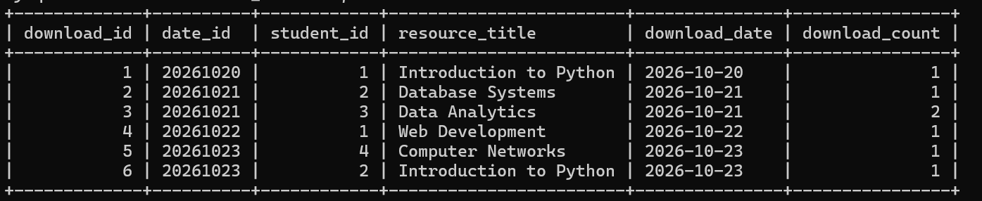
Fact tables
FACT_CHECKOUT: Records book checkout activities and links students, books, and dates.
FACT_DOWNLOAD: Records digital resource downloads, including resource title, download date, student, and download count.

Slide 9
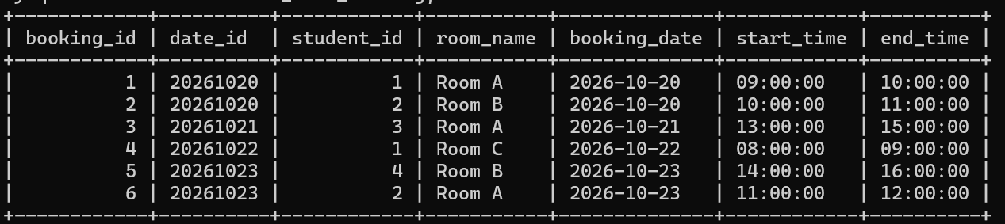
Conti
FACT_ROOM_BOOKING: Records study room bookings, including student, booking date, room name, start time, and end time.
Dimension tables provide descriptive information, while fact tables store library activities and measurable values.

Slide 10
Relationships Between Tables
The fact tables use keys to connect library activities to the appropriate dimensions:
DIM_STUDENT connects to all three fact tables.
DIM_DATE connects to all three fact tables.
DIM_BOOK connects to FACT_CHECKOUT.

Slide 11
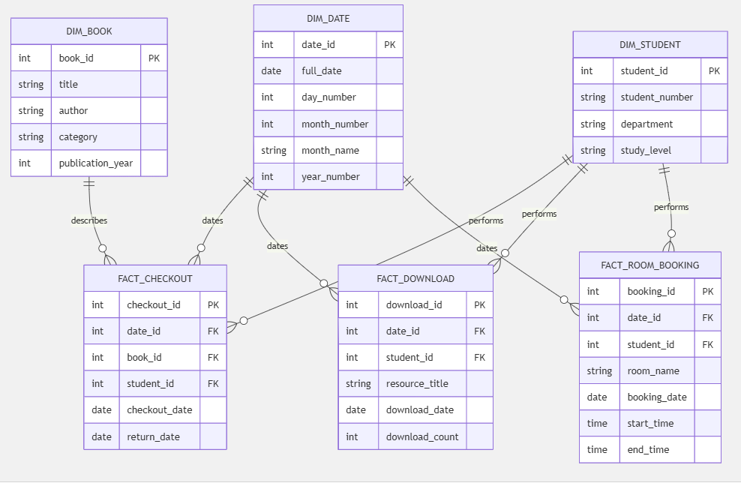
These relationships support analysis by student, date, book, and library activity.

Slide 12
Database Implementation
The data warehouse was implemented using MySQL. The database named university_library stores the dimension tables and fact tables.
Primary keys uniquely identify records, while foreign keys connect fact tables with their related dimensions.
Table | Purpose
dim_student | Stores student information
dim_book | Stores book information
dim_date | Stores calendar information
fact_checkout | Stores book checkout transactions
fact_download | Stores digital download transactions
fact_room_booking | Stores study room booking transactions

Slide 13
ETL Process
The ETL (Extract, Transform, Load) process was developed using Python.
Extract
Sample library data was generated and prepared using Python scripts. Example datasets included student records, book records, digital download records, and study room booking records.
Transform
Student numbers were validated.
Dates were standardized.
Invalid records were checked.
Download counts were prepared for analysis.
Load
The cleaned data was loaded into MySQL. During the reported ETL execution, six new digital download records and six new room booking records were loaded, and zero invalid or unmatched records were skipped.

Slide 14
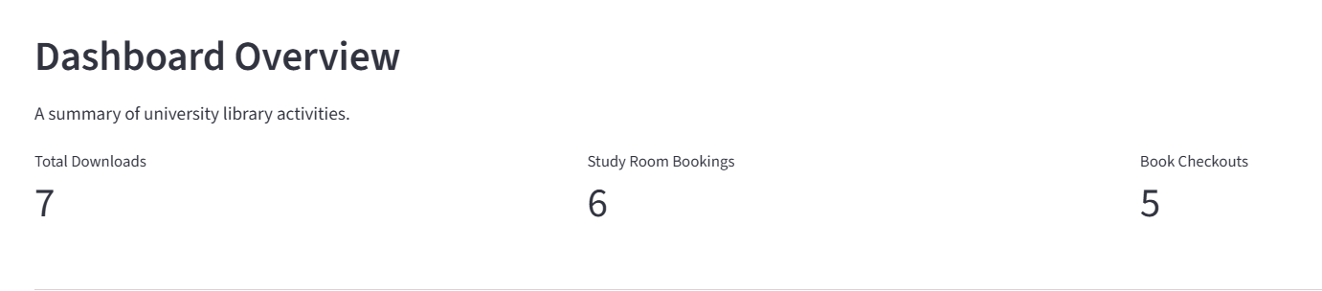
Database Validation
SQL validation queries were executed to verify the totals stored in the data warehouse.
These results confirm the reported database totals. The dashboard KPI values should also be checked directly against these totals before claiming that the dashboard and database are synchronized.
Validation test | Result | Status
Total downloads | 7 | PASS
Total room bookings | 6 | PASS
Total book checkouts | 5 | PASS

Slide 15
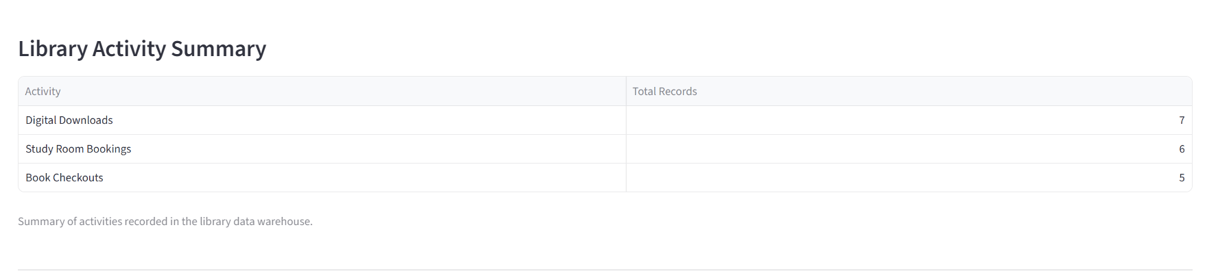
Dashboard and OLAP Analysis
6.1 Dashboard Implementation
An interactive dashboard was developed using Streamlit and connected to the MySQL data warehouse. It provides a simple interface for monitoring and analyzing university library activities.
The dashboard displays these key performance indicators:
Total digital downloads.
Total study room bookings.
Total book checkouts.
It also includes visualizations for downloads over time, bookings by room, and book checkouts by category.

Slide 16
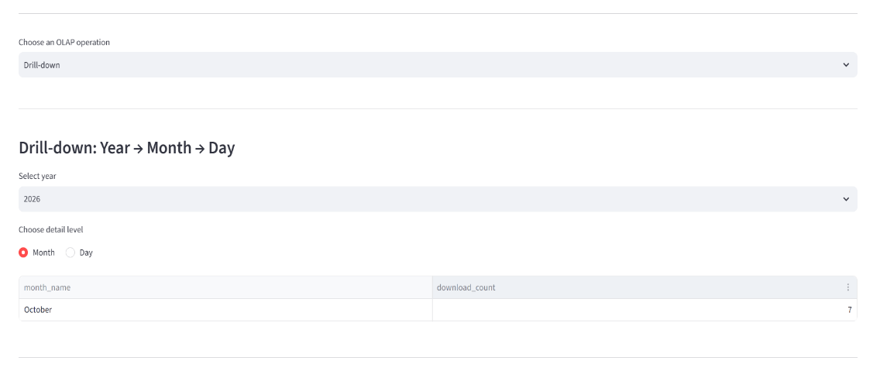
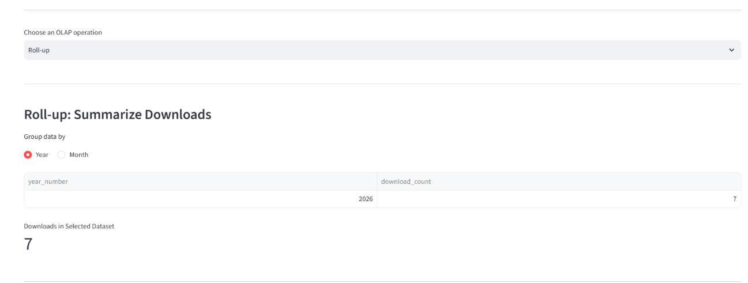
OLAP Operations
Online Analytical Processing (OLAP) operations allow users to explore data from different perspectives.
Drill-down: Moves from summarized information to more detailed information, such as from yearly downloads to monthly downloads.
Roll-up: Summarizes detailed information into higher-level groups, such as combining monthly downloads into yearly totals.

Slide 17
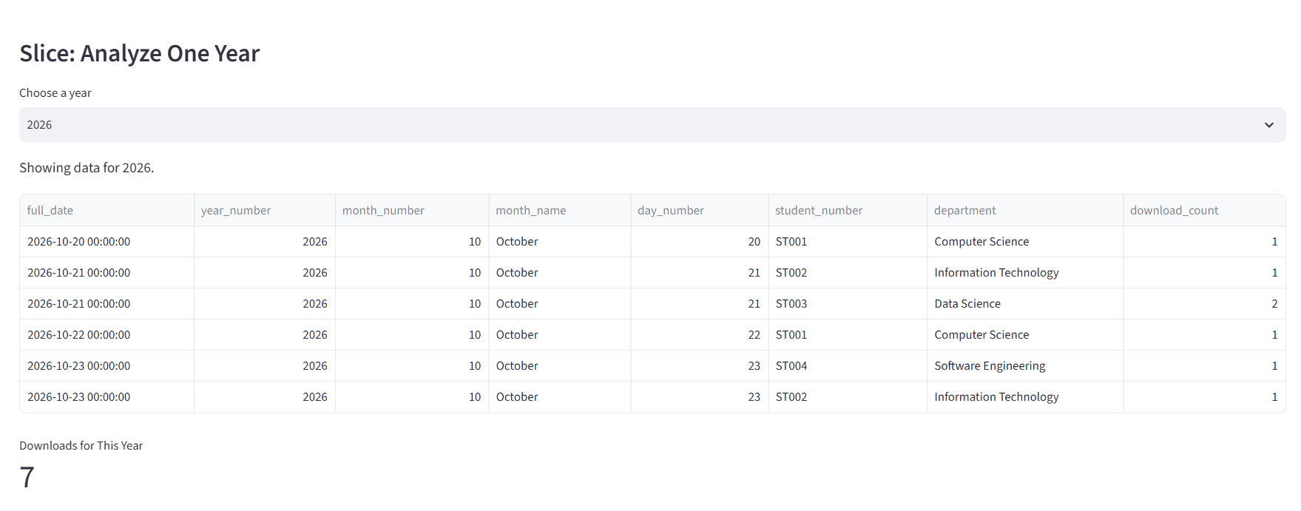
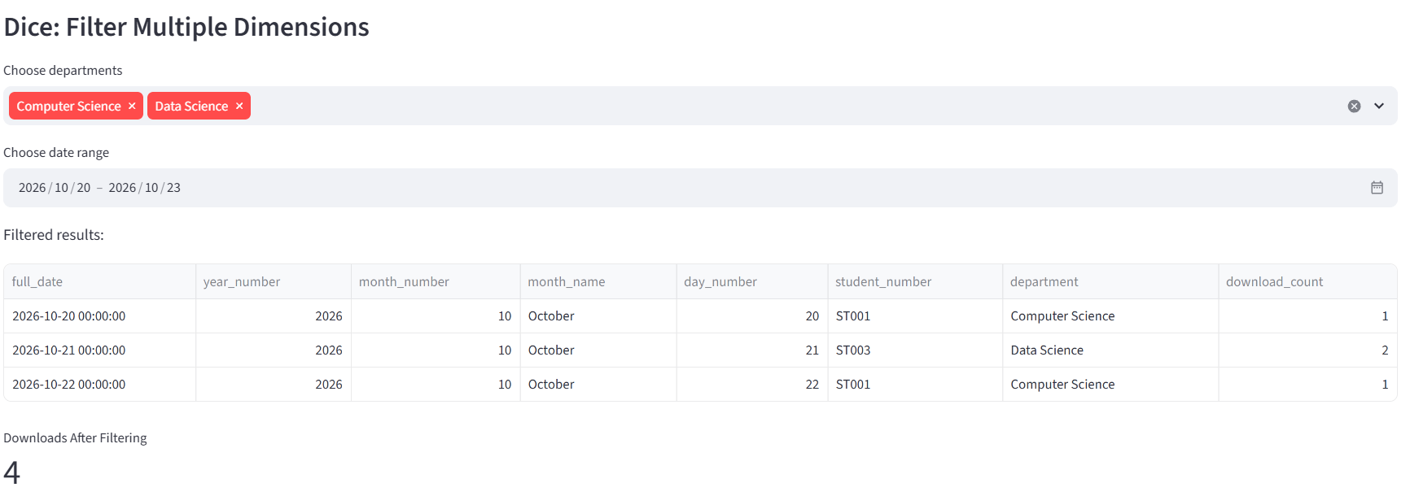
Slice: Filters data using one selected dimension value, such as analyzing downloads for a particular year.
Dice: Filters data using multiple conditions, such as selecting a particular year and department.
Pivot: Changes how data is arranged in a report to compare different dimensions and measures.

Slide 18
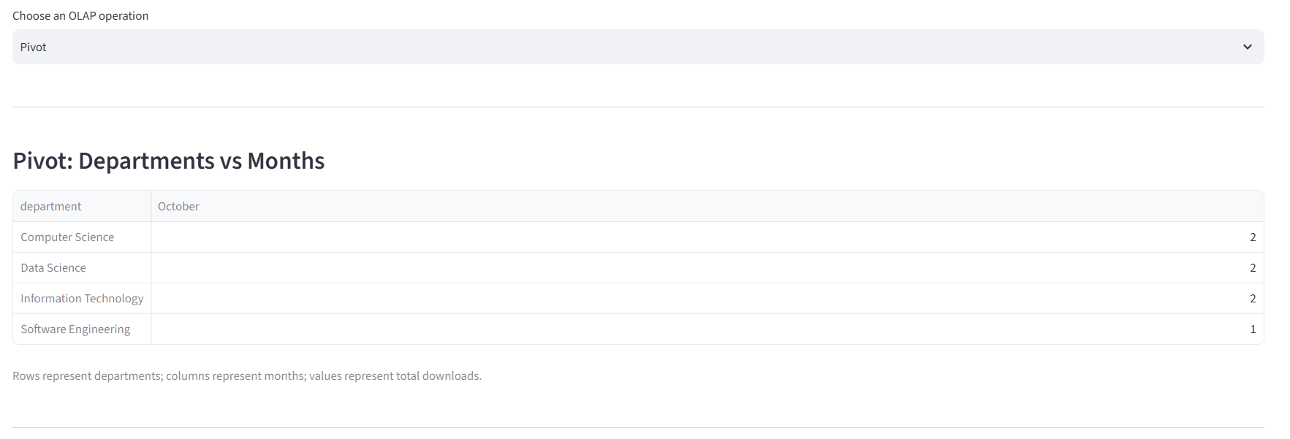
These operations help users investigate library usage patterns and generate analytical insights.
Each screenshot should clearly show the relevant dashboard section and its results.

Slide 19
Testing and Validation
Database Testing
Three SQL validation tests passed: total downloads (7), room bookings (6), and book checkouts (5).
ETL Testing
The ETL process completed successfully for the reported run, loading six new download records and six new room booking records with zero invalid or unmatched records skipped.
Dashboard and OLAP Testing
The Streamlit dashboard was launched successfully, and the five OLAP controls—drill-down, roll-up, slice, dice, and pivot—were reported to work during functional testing. Additional result-level testing should confirm that each operation returns the correct results for different selections and that dashboard totals remain consistent with the database.

Slide 20
End of presentation

